Slide 1

Program Studi Magister Teknik Informatika
Institut Teknologi Bandung

Slide 2
first generation DBMSs
  1060s-1970s
  two approaches: hierarchical and network
  main problems: complex programs needed to be written to answer simple queries (navigational databases); minimal data independence; no widely accepted theoretical foundations
second generation
  1970 - Codd’s paper
  1970-1980 - many experimental relational DBMSs
  now: over 100 commercial DBMSs (some stretch the definition of a relational DBMS)
third generation … (“to be continued”)

Slide 3

both in terms of structure of data and of operations to be performed on data
  computer aided design (CAD)
  computer aided manufacturing (CAM)
  computer aided software engineering (CASE)
  office information systems, multimedia systems and digital publishing
  geographic information systems
  etc.

Slide 4

poor representation of real world entities
semantic overloading
poor support for integrity constraints
homogeneous data structure
limited operations
difficulty in handling recursive queries
impedance mismatch
other problems ...

Slide 5

normalisation -> fragmentation
  relations that have no correspondent in the real world
  to infer information -> joins -> very costly
poor semantics
  everything is a RELATION

Slide 6
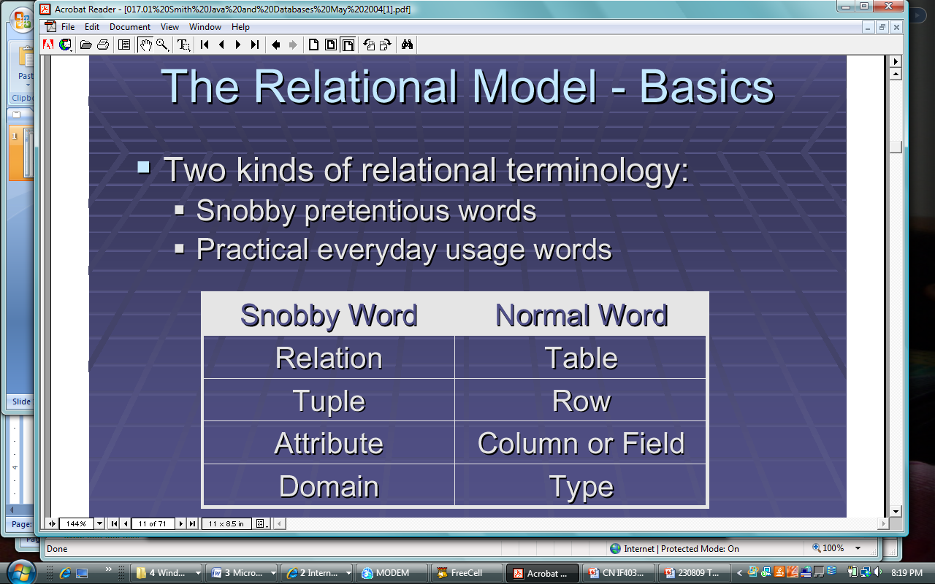

Slide 7

no distinction between entity and relationship; no distinction between different types of relations (e.g. “has”, “is the parent of”, “has the address”, “is located”, “earns”)
  result: this semantic cannot be expressed (e.g. be build into the operators)
there is very little meaning in relations (i.e. the systems “knows” very little of the data it contained); what solutions to increase the semantics exist?
  domains - provided by the relational model, but not fully supported by relational DBMSs
  keys - provided and supported
  support for enterprise integrity constraints …?

Slide 8

integrity ≡ validity and consistency
entity integrity + referential integrity + domains
  many systems do not fully support → build them into applications
  → effort + inconsistencies
integrity is expressed in terms of constraints (rules that the database must comply with)
  the constraint checking mechanism is simple
    degree of compliance; categories of integrity constraints ...
  what does it mean must comply with?
    what is the logical model? must be deduced from the DB? the DB must be consistent with them? must be true of the DB?
the relational model does not support enterprise integrity constraints
  SQL provides support for constraints as part of the DB def.

Slide 9

horizontal and vertical homogeneity
  too restrictive
  real world objects have a more complex structure
  result: unnatural structures + many joins (inefficient)
  example: composite parts
  on the other hand, this symmetric structure is one of the strengths of the relational model (why?)
binary large objects (BLOB)
  are allowed
  typically, they are references to files, therefore some advantages provided by DBMSs may be lost (e.g. security)
  their inner structure cannot be accessed

Slide 10

only a fix set operations
  tuple oriented
  set oriented
not sufficient for many applications (e.g. geographic information systems - distance, area, …)
new operations cannot be specified
  some DBMSs allow for type extensibility (melalui program aplikasi)

Slide 11

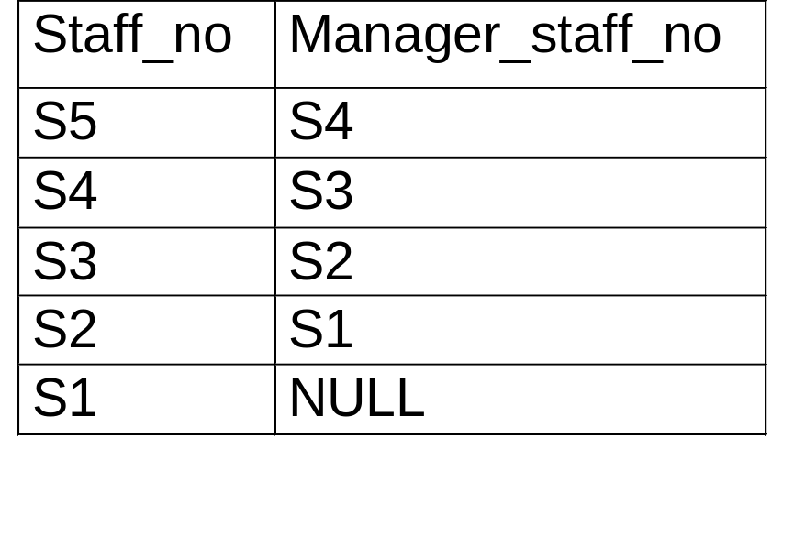
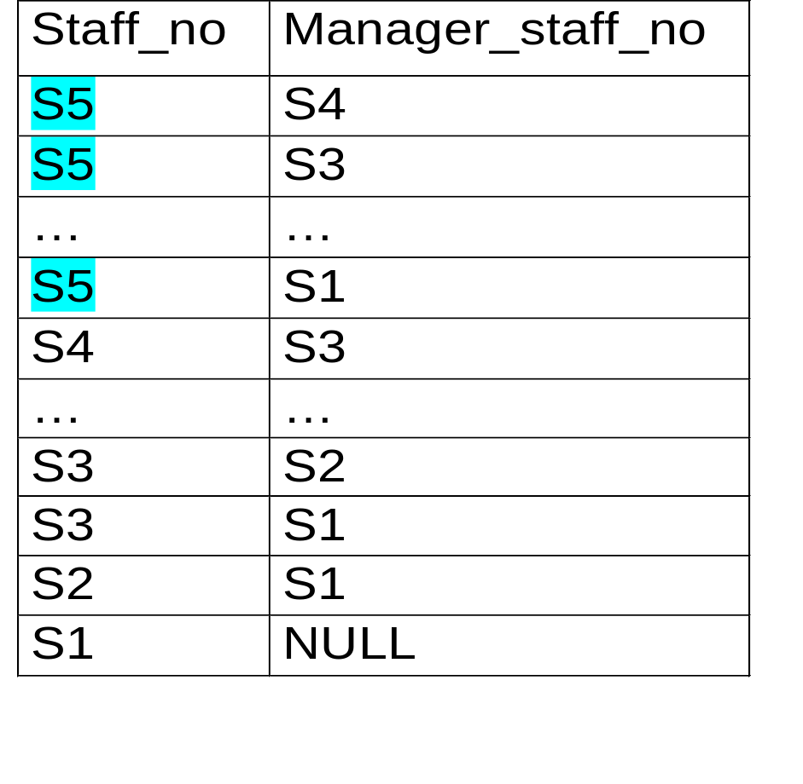

Slide 12

SQL92 lacks computational completeness
solution: embedded SQL
drawback of solution: impedance mismatch
  mixing different paradigms
    SQL: set based operators
    high level programming languages: record based (or even less) (example C)
      conversion to records needed (inefficient!)
    type mismatch
  solution by Date: build set level facilities in high level programming languages

Slide 13

other problems also exist
  no support for long lived transactions (not inherent to the relational model)
  schema amendments - difficult
  poor navigational access
therefore, other approaches might be needed

Slide 14
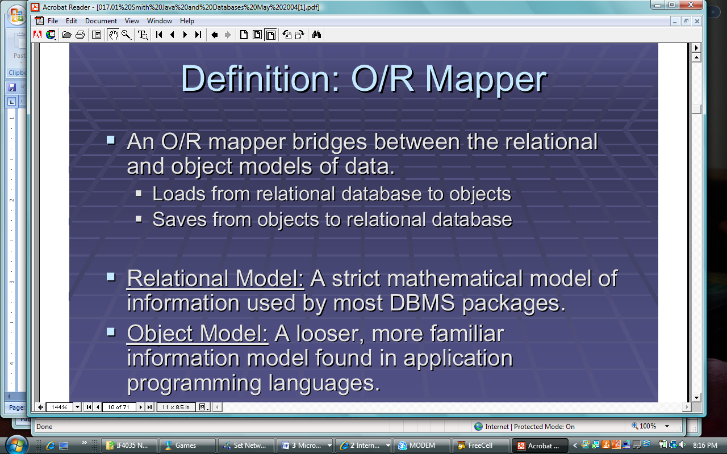

Slide 15
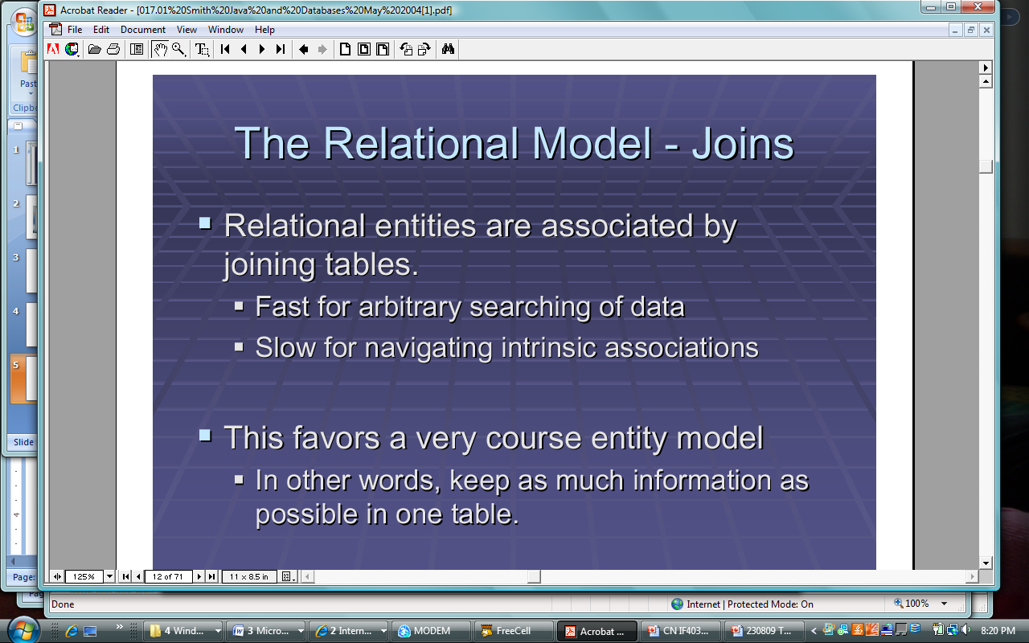

Slide 16
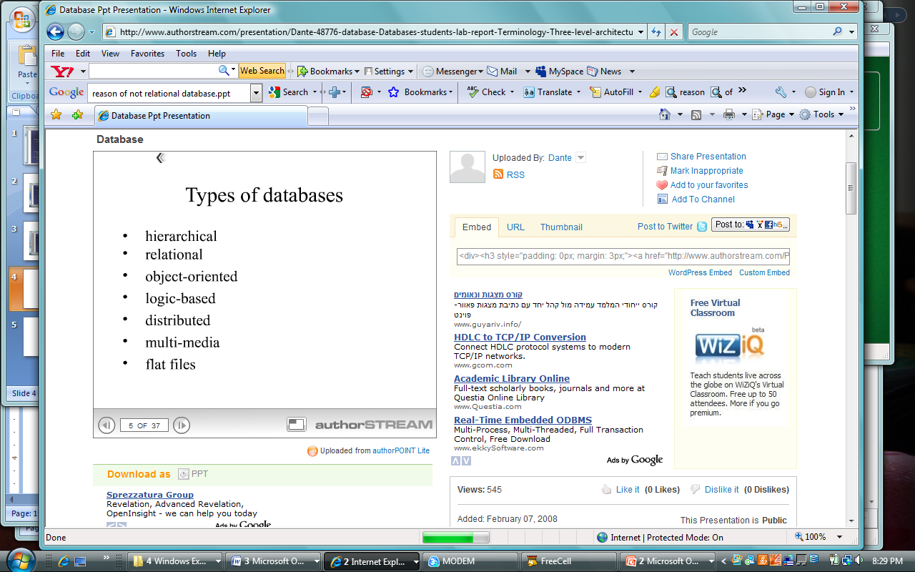

Slide 17
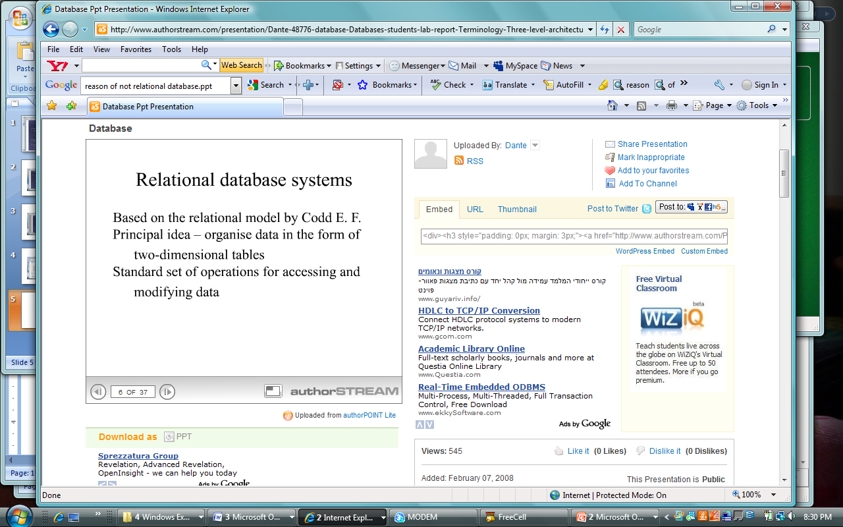

Slide 18
TUGAS 4:
Jelaskan Kelemahan model RELASI, mencakup :
DESIGN :
  Transformasi “real-world” menjadi skema
  Fragmentasi data dalam sejumlah file
  Struktur statis
IMPLEMENTASI :
  Operator kurang lengkap (ie. Hirarki)
  Cost pengaksesan (operator join)

